Slide 1
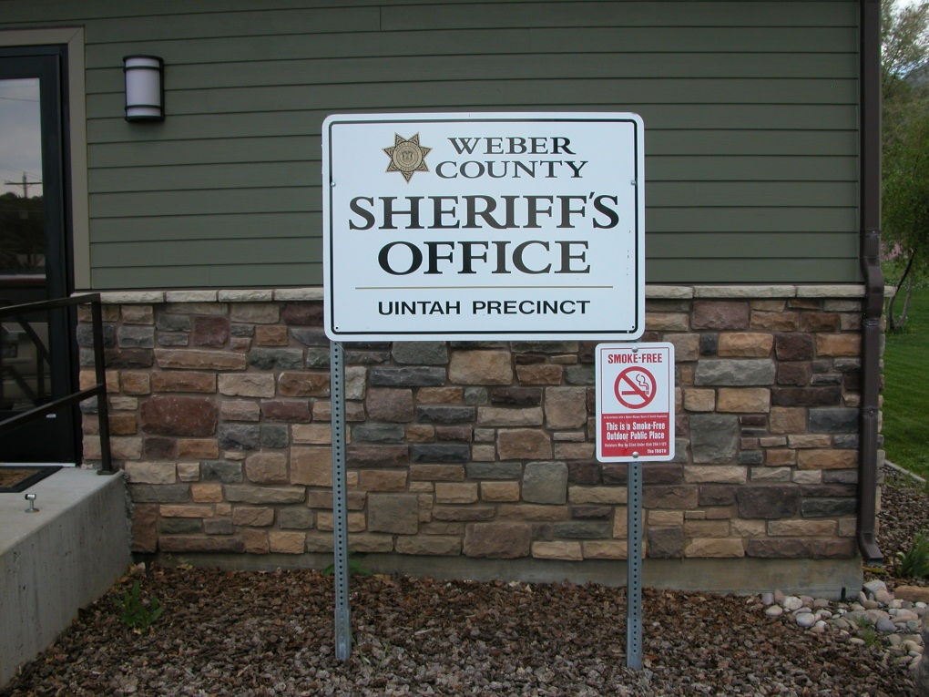
WEBER COUNTY SHERIFF’S OFFICE UINTAH CITY
2013 QUARTERLY REPORT

Slide 2
CALL BREAKDOWN
 |  | REPORTS
CALL DESCRIPTION | TOTAL | 49 | CALL DESCRIPTION | TOTAL
911 calls | 2 |  | Paper service | 1
Alarms | 1 |  | Premise checks | 11
Animal complaints | 5 |  | Sex offenses | 0
Assaults | 0 |  | Shooting in city limits | 2
Assist Fire department | 1 |  | Stolen vehicles | 0
Assist other jurisdictions | 2 |  | Suspicious activity | 2
Burglaries | 0 |  | Thefts | 0
Citizen assists | 1 |  | Traffic accidents fatal | 1
Civil disputes | 4 |  | Traffic accident property | 4
Community policing | 2 |  | Traffic hazards | 1
Criminal mischief | 0 |  | Traffic stops | 12
Curfew violations | 1 |  | Threats | 1
Disturbance – family | 1 |  | Trespassing | 1
Drug violations | 0 |  | Vehicle burglaries | 0
Frauds | 2 |  | Vehicle impounds | 1
Medicals | 2 |  | Warrants | 0
JANUARY
87 CALLS
Priority 1 – 26
Priority 2 – 8
Priority 3 – 26
Priority 4 – 24
Priority 5 – 0
Priority 6 - 3

Slide 3
MAJOR INCIDENTS
#13-1772 Fatal Traffic Accident
January 15th at 1550 hours
6600 S. Hwy 89
Single vehicle traveling southbound struck the guardrail twice at the bottom of the dug way
The 90 year-old driver was found unresponsive in the backseat
The subject suffered from a medical problem before the crash
5 deputies responded to the scene

Slide 4
CALLS FOR SERVICE 5-YEAR COMPARISON
TOTAL CALLS
2009 40
2010 68
2011 70
2012 65
2013 87

Slide 5
CITATIONS 5-YEAR COMPARISON

Slide 6
CALL BREAKDOWN
 |  | REPORTS
CALL DESCRIPTION | TOTAL | 35 | CALL DESCRIPTION | TOTAL
Abandoned vehicles | 1 |  | Motorist assists | 2
Alarms | 1 |  | Protective order service | 1
Animal complaints | 7 |  | Sex offenses | 0
Assaults | 0 |  | Stolen vehicles | 0
Assist other jurisdictions | 1 |  | Suspicious activity | 3
Burglaries | 1 |  | Telephone harassment | 1
Citizen assists | 1 |  | Thefts | 1
Community policing | 5 |  | Threats | 1
Criminal mischief | 0 |  | Traffic accidents injury | 1
Disorderly conduct | 1 |  | Traffic accident property | 2
Disturbance family | 1 |  | Traffic hazards | 1
Drug violations | 1 |  | Traffic stops | 14
Extra Patrol | 1 |  | Vehicle burglaries | 0
Medicals | 1 |  | Warrants | 0
FEBRUARY
78 calls
Priority 1 – 21
Priority 2 – 8
Priority 3 – 22
Priority 4 – 17
Priority 5 – 0
Priority 6 - 10

Slide 7
MAJOR INCIDENTS
#13-6522 Aggravated Assault (DV) – 975 E. 6600 S. Two brothers 17 & 18 years-old, got into an argument over one of them leaving a dish in the other one’s room. The two started physically fighting and then the older brother grabbed a “Rambo-style” knife and went after the younger one. The father intervened and secured the knife. Both brothers were charged with assault. 2 deputies on scene.
#13-5033 Storage Shed Burglary – 2403 E. 6600 S. Forced entry was made into one of the units and the suspects stole grass seed and others supplies.
#13-6902 Stolen iPad – 6726 S. 1540 E. A brand new iPad was stolen. The juvenile didn’t know where exactly it was taken from. The theft possibly occurred at Crossroads Fitness.
#13-6477 Drug paraphernalia – 1800 E. 6900 S. A mother found a marijuana pipe in her son’s backpack. A citation was issued for the subject to appear in juvenile court.

Slide 8
CALLS FOR SERVICE 5-YEAR COMPARISON
TOTAL CALLS
2009 40
2010 49
2011 59
2012 69
2013 78

Slide 9
CITATIONS 5-YEAR COMPARISON

Slide 10
CALL BREAKDOWN
 |  | REPORTS
CALL DESCRIPTION | TOTAL | 33 | CALL DESCRIPTION | TOTAL
911 calls | 1 |  | Reckless driver | 1
Animal complaints | 4 |  | Sex offenses | 0
Assaults | 1 |  | Stolen vehicles | 0
Assist other jurisdictions | 1 |  | Suspicious activity | 2
Burglaries | 0 |  | Telephone harassment | 1
Citizen assists | 1 |  | Thefts | 1
Community policing | 2 |  | Traffic accidents injury | 0
Criminal mischief | 0 |  | Traffic accident property | 4
Disturbance - family | 1 |  | Traffic hazards | 3
Drug violations | 0 |  | Traffic stops | 13
Intoxication | 1 |  | Trespassing | 1
Medicals | 2 |  | Vehicle burglaries | 0
Premise checks | 6 |  | Warrants | 0
MARCH
75 calls
Priority 1 – 30
Priority 2 – 5
Priority 3 – 20
Priority 4 – 19
Priority 5 – 0
Priority 6 - 1

Slide 11
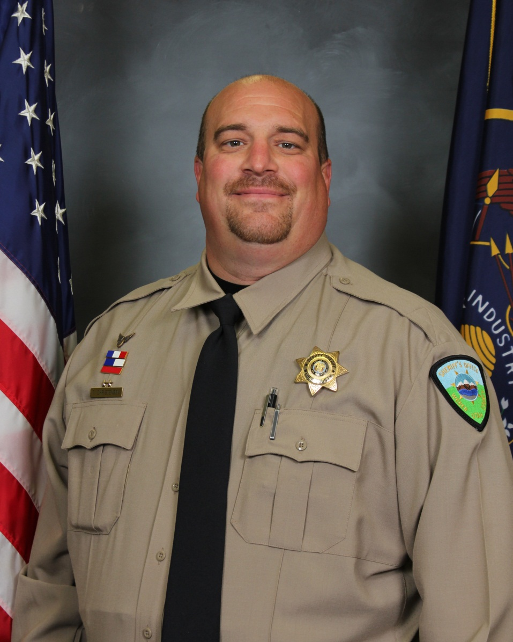
MAJOR INCIDENTS
#13-11029 AGGRAVATED ASSAULT (DV) - 2500 E. 6550 S. A male attempted to commit suicide by cutting his wrist with a razor. When his wife found him, he grabbed her and starting choking her. Deputy Christensen arrived and he deployed a Taser. The suspect was eventually subdued and taken to the hospital. There were two children in the home. Four deputies were on scene for nearly three hours.

Slide 12
MAJOR INCIDENTS
#13-10002 ASSAULT – 975 E. 6600 S. Two juveniles ages 9-10 years-old, were playing with BB guns when one of them got mad at the other one and threw his gun at him. In retaliation for being hit in the face, the other kid shot his friend with his gun. There were no major injuries and no charges were filed due to the age of the subjects. 2 deputies on scene.
#13-8480 THEFT – 6640 S. Hwy 89. About $1000 in rock was stolen from the abandoned Natural Rock & Design site. There is no suspect information.
#13-10914 INTOXICATION – 2580 E. 6550 S. An intoxicated male was found trespassing at this residence at 0255 hours. He said he was “looking for scrap metal.” He was arrested and booked into the jail. 3 deputies on scene.

Slide 13
CALLS FOR SERVICE 5-YEAR COMPARISON
TOTAL CALLS
2009 49
2010 70
2011 75
2012 90
2013 75

Slide 14
CITATIONS 5-YEAR COMPARISON

Slide 15
CALL BREAKDOWN
 |  | REPORTS
CALL DESCRIPTION | TOTAL | 34 | CALL DESCRIPTION | TOTAL
Alarms | 1 |  | Protective order service | 1
Animal complaints | 4 |  | Reckless driver | 1
Assaults | 0 |  | Sex offenses | 0
Burglaries | 0 |  | Stolen vehicles | 0
Citizen assists | 2 |  | Suspicious activity | 6
Civil disputes | 1 |  | Thefts | 5
Criminal mischief | 0 |  | Traffic accidents injury | 0
Disturbance - family | 0 |  | Traffic accident property | 6
Drug violations | 0 |  | Traffic hazards | 1
Extra patrols | 1 |  | Traffic stops | 5
Medicals | 2 |  | Trespassing | 1
Neighborhood problems | 1 |  | Vehicle burglaries | 0
Premise checks | 1 |  | Warrants | 0
APRIL
58 calls
Priority 1 – 15
Priority 2 – 8
Priority 3 – 27
Priority 4 – 6
Priority 5 – 0
Priority 6 - 2

Slide 16
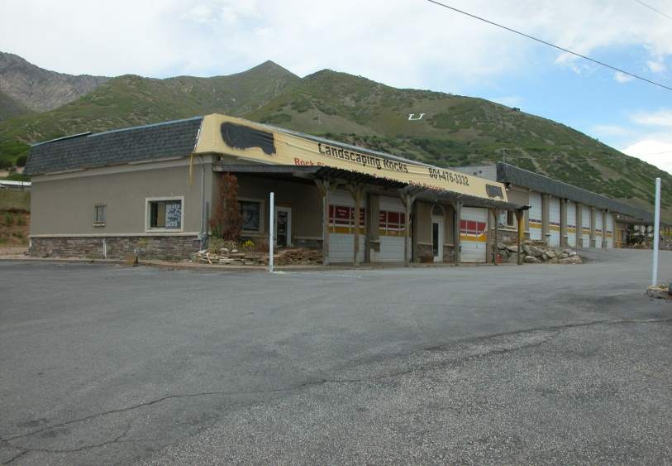
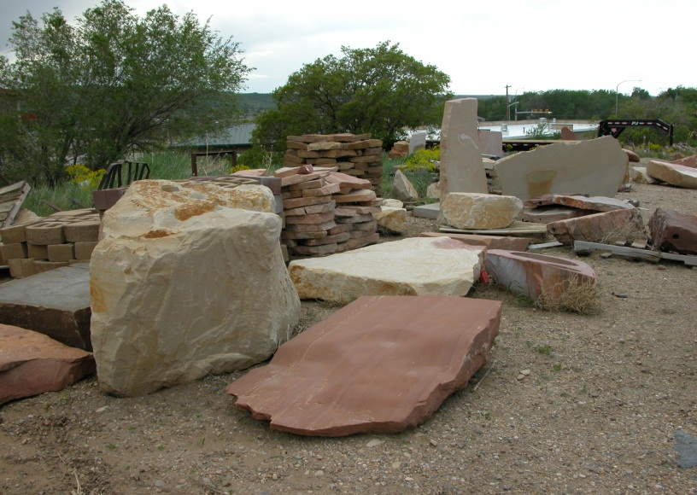
MAJOR INCIDENTS
NATURAL ROCK & DESIGN
24 calls for service so far this year.
On 04/04/13, two individuals were arrested for theft.
These same two males were suspects in another theft case.
On 04/15/13, another person was cited for stealing materials from the yard.
Deputies continue to respond on theft, trespassing, and suspicious person and vehicle calls at the business.
6640 S. Hwy 89

Slide 17
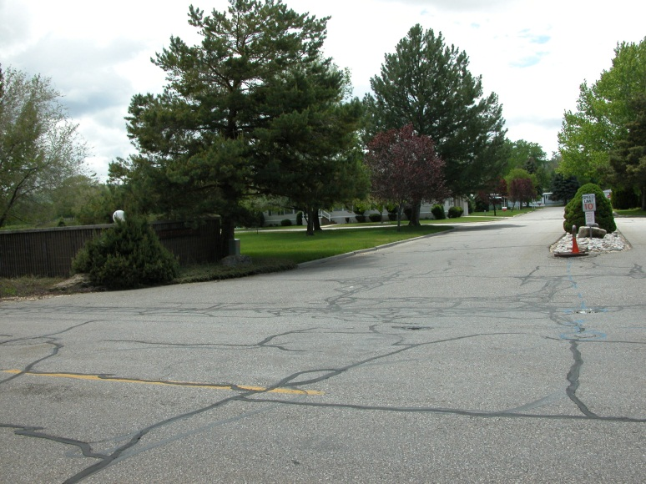
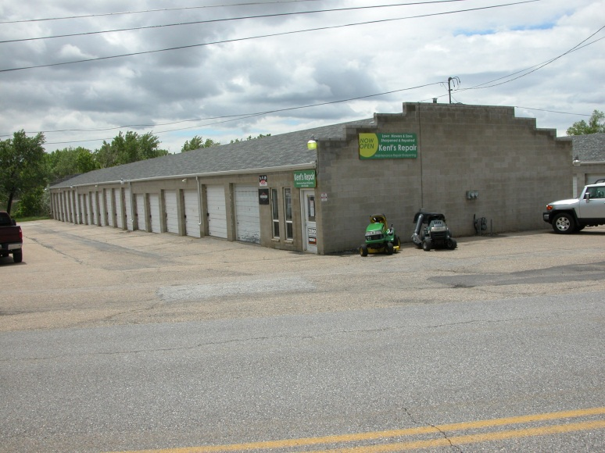
OTHER INCIDENTS
#13-11757 THEFT – 1731 E. 6600 S. A green canoe was stolen from the side of this property near the residence. There is no suspect information.
#13-12222 THEFT – 975 E. 6600 S. A small, girl’s bike was stolen from the yard of this residence. There is no suspect information.

Slide 18
CALLS FOR SERVICE 5-YEAR COMPARISON
TOTAL CALLS
2009 85
2010 94
2011 73
2012 85
2013 58

Slide 19
CITATIONS 5-YEAR COMPARISON

Slide 20
CRIME PATTERNS AND CONCERNS
Overall call volume increased the first two months of 2013, but declined in March and April.
Overall, violent crime and property crime rates remain relatively low.
There have been several high-priority incidents including a fatal car accident on Hwy 89, and two domestic violence-related aggravated assault calls.
The abandoned business of Natural Rock & Design has been a hot spot for thefts, trespassing and suspicious activity calls.
No other significant crime patterns have been be detected.

Slide 21
CALLS FOR SERVICE 5-year Comparison
TOTAL CALLS
2008 931
2009 1000
2010 799
2011 1010
2012 941

Slide 22
CITATIONS 5-year Comparison
TOTAL TICKETS
2008 291
2009 543
2010 358
2011 343
2012 316

Slide 23
PROACTIVE = PREVENTION

Slide 24
10-year ComparisoN

Slide 25
10-year ComparisoN

Slide 26
SCHOOL VISITS
UINTAH Elementary
Jan – 8
Feb – 10
MAR – 9
APR- 7
WELCOME SCHOOL RESOURCE
OFFICER MIKE CHATELAIN!

Slide 27
BIKE PATROL
QUIET AND COVERT
ALLOWS FOR DETECTION THROUGH SIGHT AND SOUND
GREAT FOR RESIDENTIAL AREAS

Slide 28
PREMISES CHECKS
JANUARY = 11
February = 0
March = 6
April = 1

Slide 29
QUESTIONS?

